Slide 1
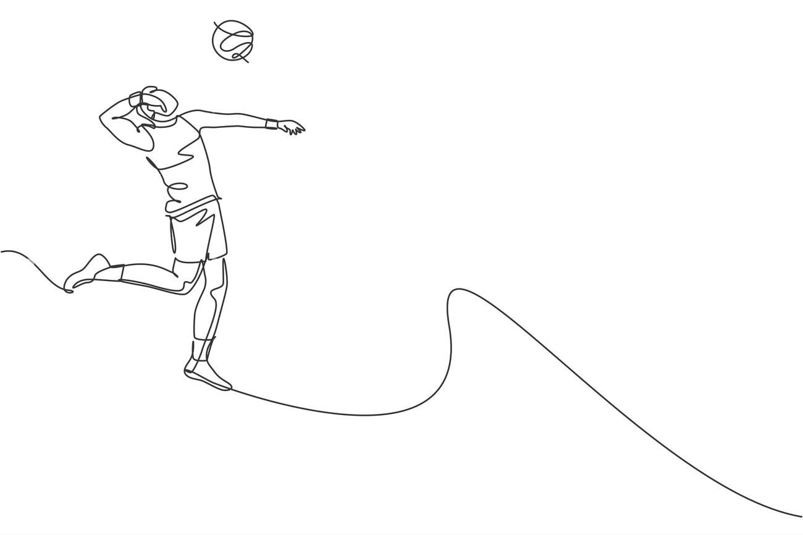

ProJump
IMU-based
Jump Height Measurement
Group members:
Thomas, Abren, Shubh, Sokol, Negar
Notes:
Hello, I am… this is…. And we are going to introduce our project we’ve modestly dubbed ProJump

Slide 2
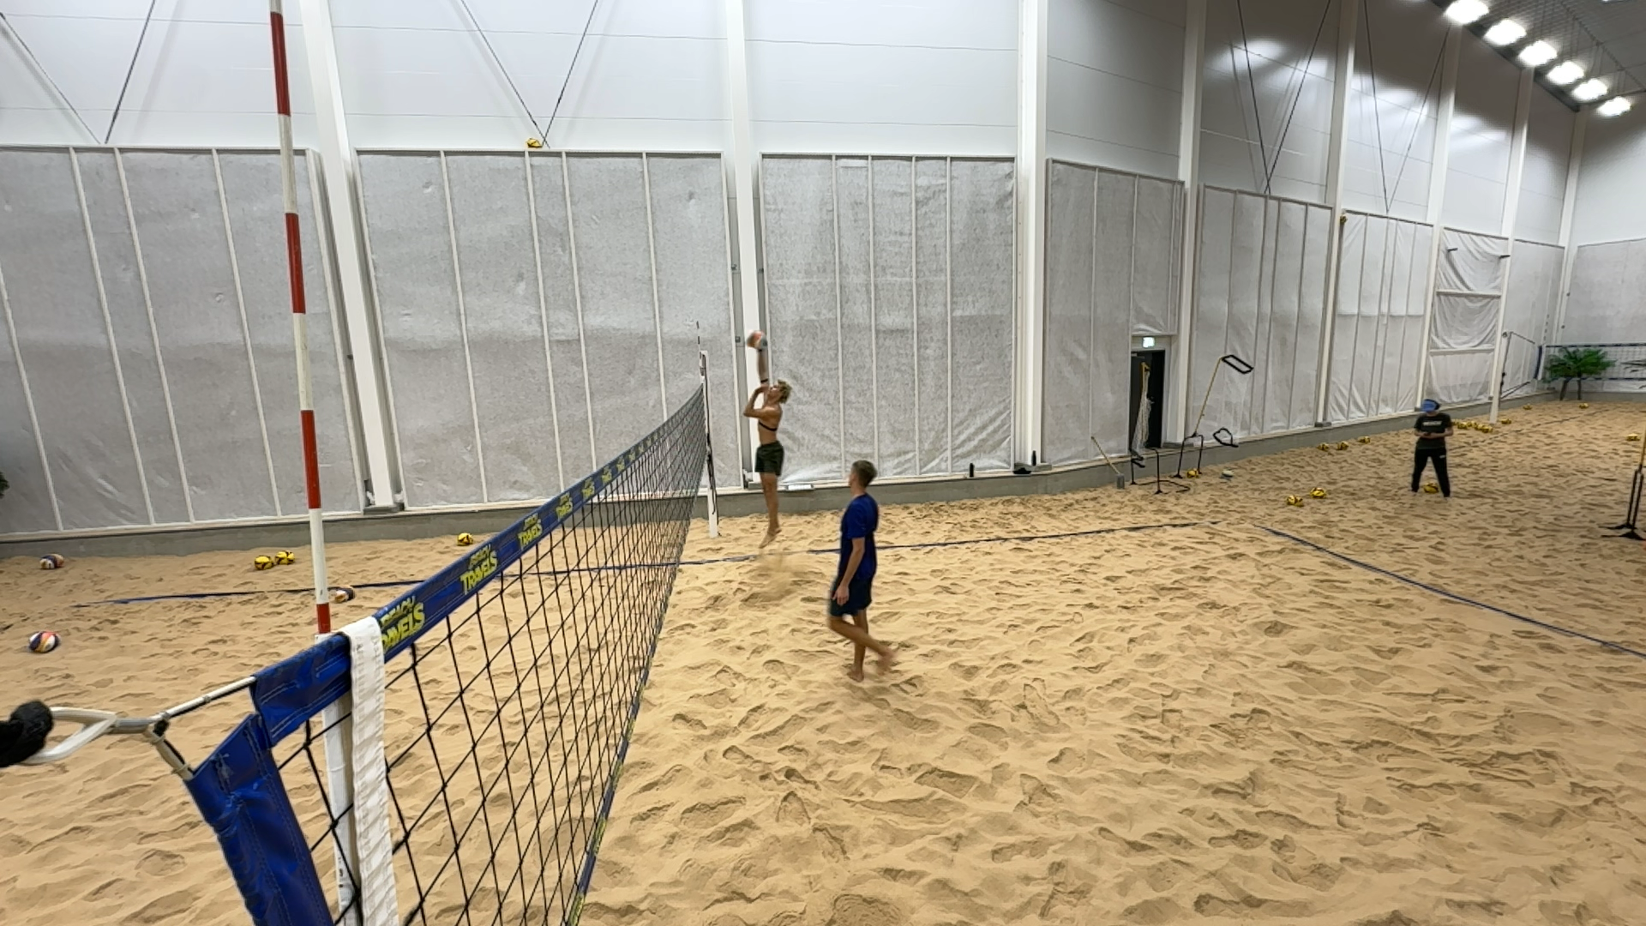
Project introduction
Overview
IMU application to detect jumps and measure jump height
IMU in-field and in-game measurements
Jump detection
Filtering
Jump height measurement
Video capture and force plate validation
Easy to use app user interface
Users
Volleyball players
Coaches
Other jump sports professionals and coaches
Weekend warriors
Notes:
Hello we are…
We are developing an application to detect jumps and measure their height using IMU.. there are several steps in the process which we shall go into more detail about
The intended users are initially Volleyball players, but we think that this app can have more universal application

Slide 3
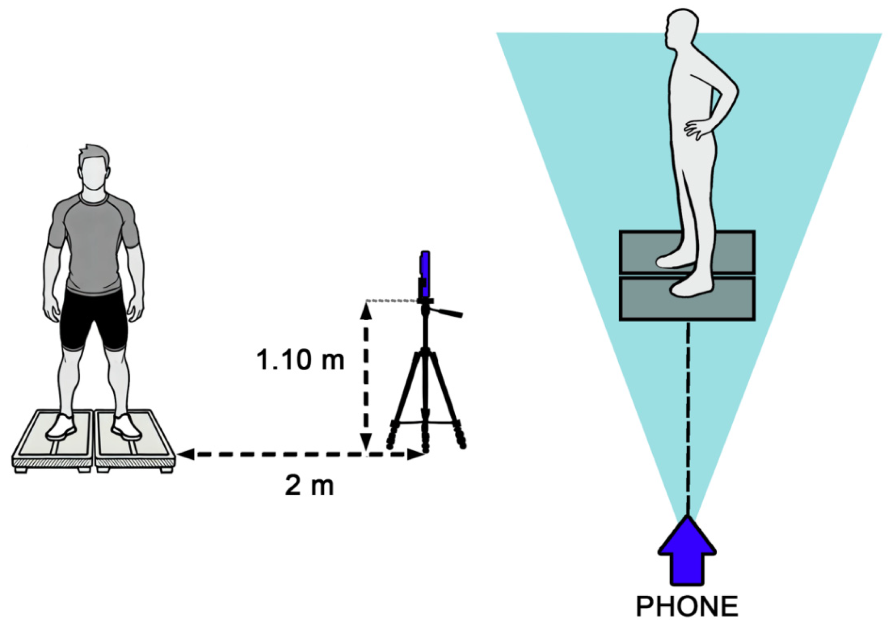
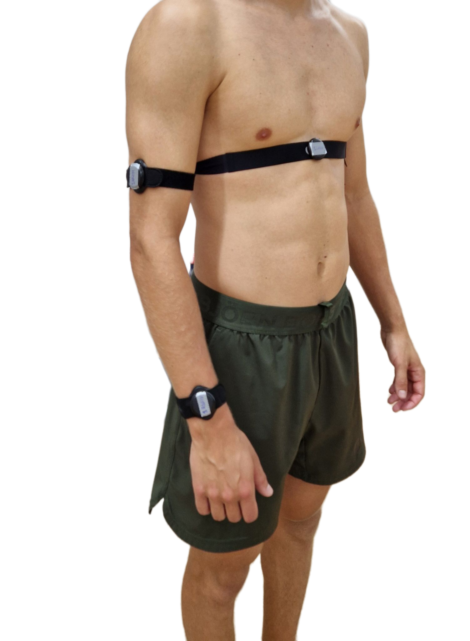
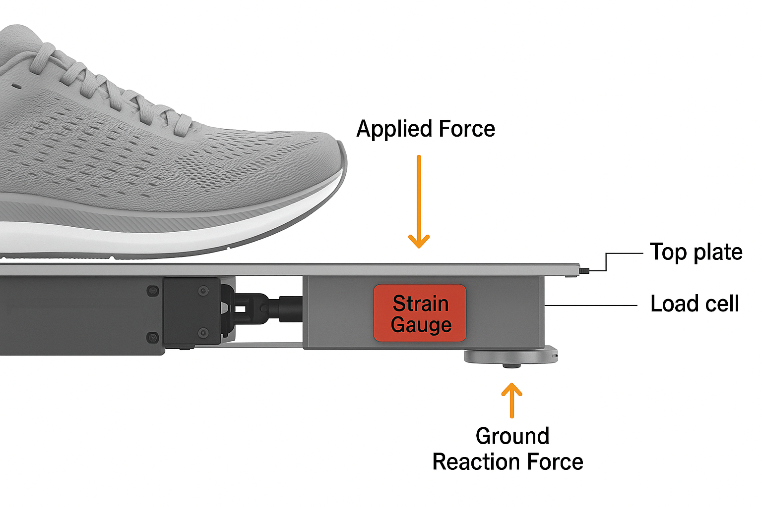
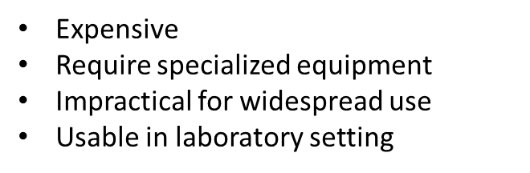


Problem Statement
Prior Techniques:
New Technique:
Force Plate / Motion Capture
IMU (Inertial Measurement Unit) Sensor
Notes:
The main issue with jump height measurement currently is that it is confined to the laboratory and is pretty expensive, especially the gold standard measurement using force plates is very accurate but does not allow widespread use and especially not in-field
This is the main advantage with inertial measurement units (IMU) as well as being relatively cheap

Slide 4
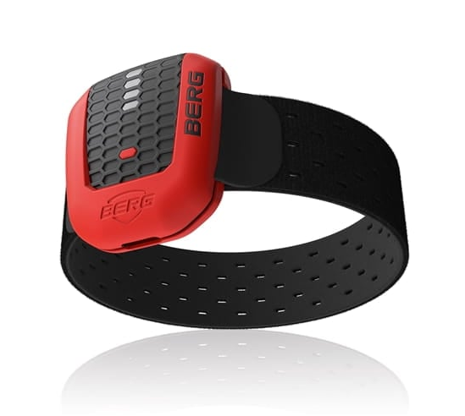
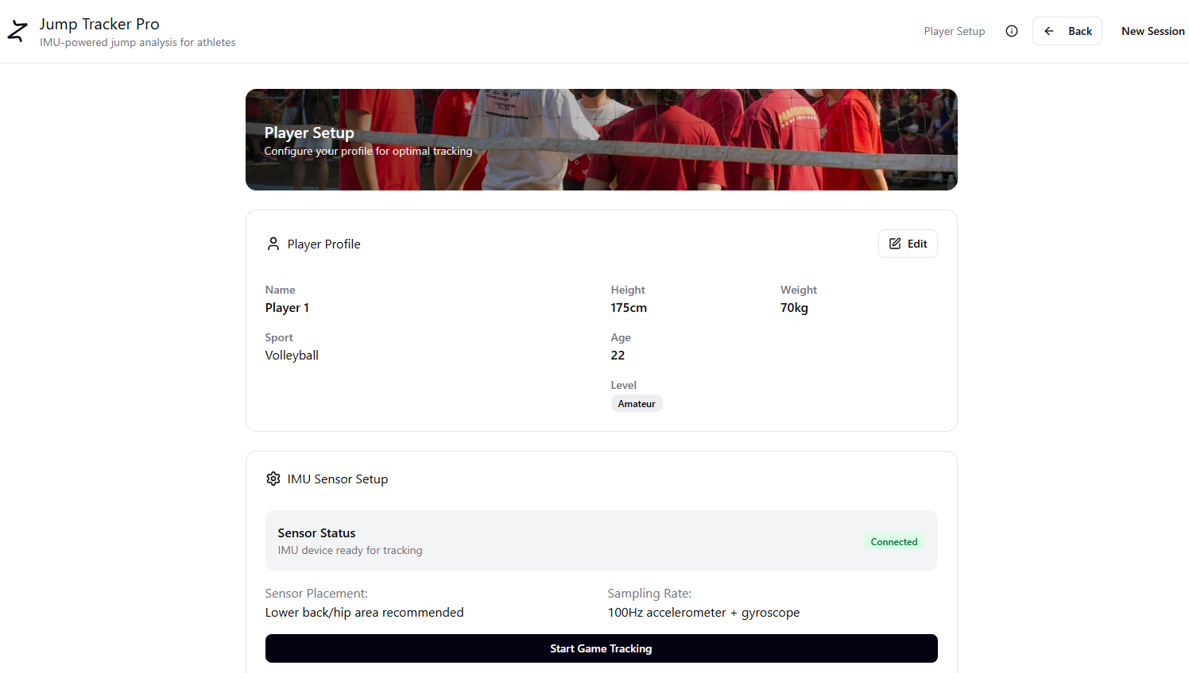
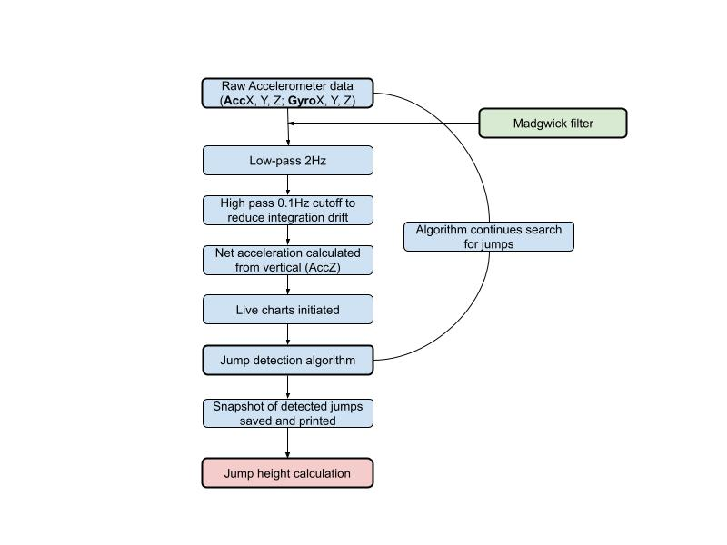
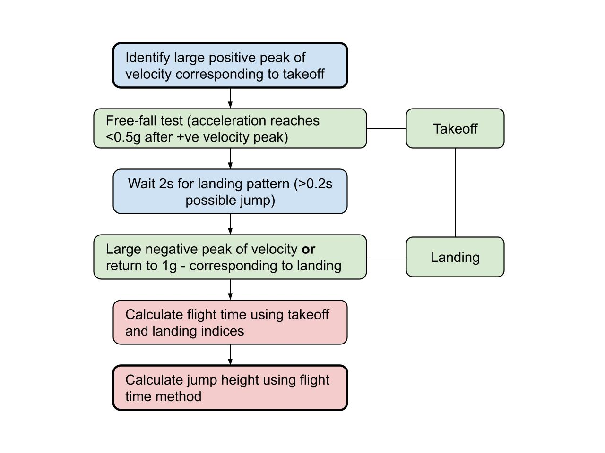
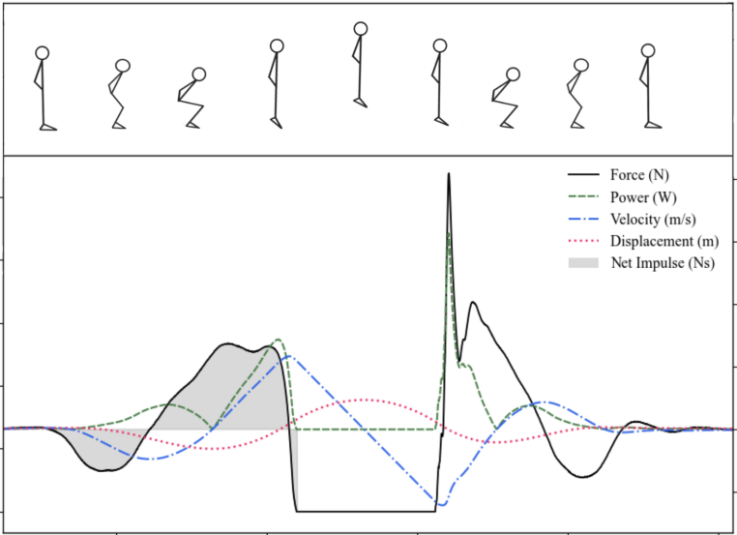
Technical Approach
2. Mobile app
Exploratory data analysis, visualization and jump detection
Real-time jump detection Jump height calculation
Snarberg, 2024
Notes:
One aspect of working with IMU data is that it’s noisy and requires a fair bit of filtering, so the first step was to make sure we could work with the data and see if we could develop an algorithm to detect jumps and subsequently accurately estimate jump height
This method we have developed based on the work of Hanna Snarberg in her masters thesis last year
AHRS (Attitude and Heading Reference System)
Once we have a working algorithm we want to incorporate this into an application which is designed with the end users in mind

Slide 5
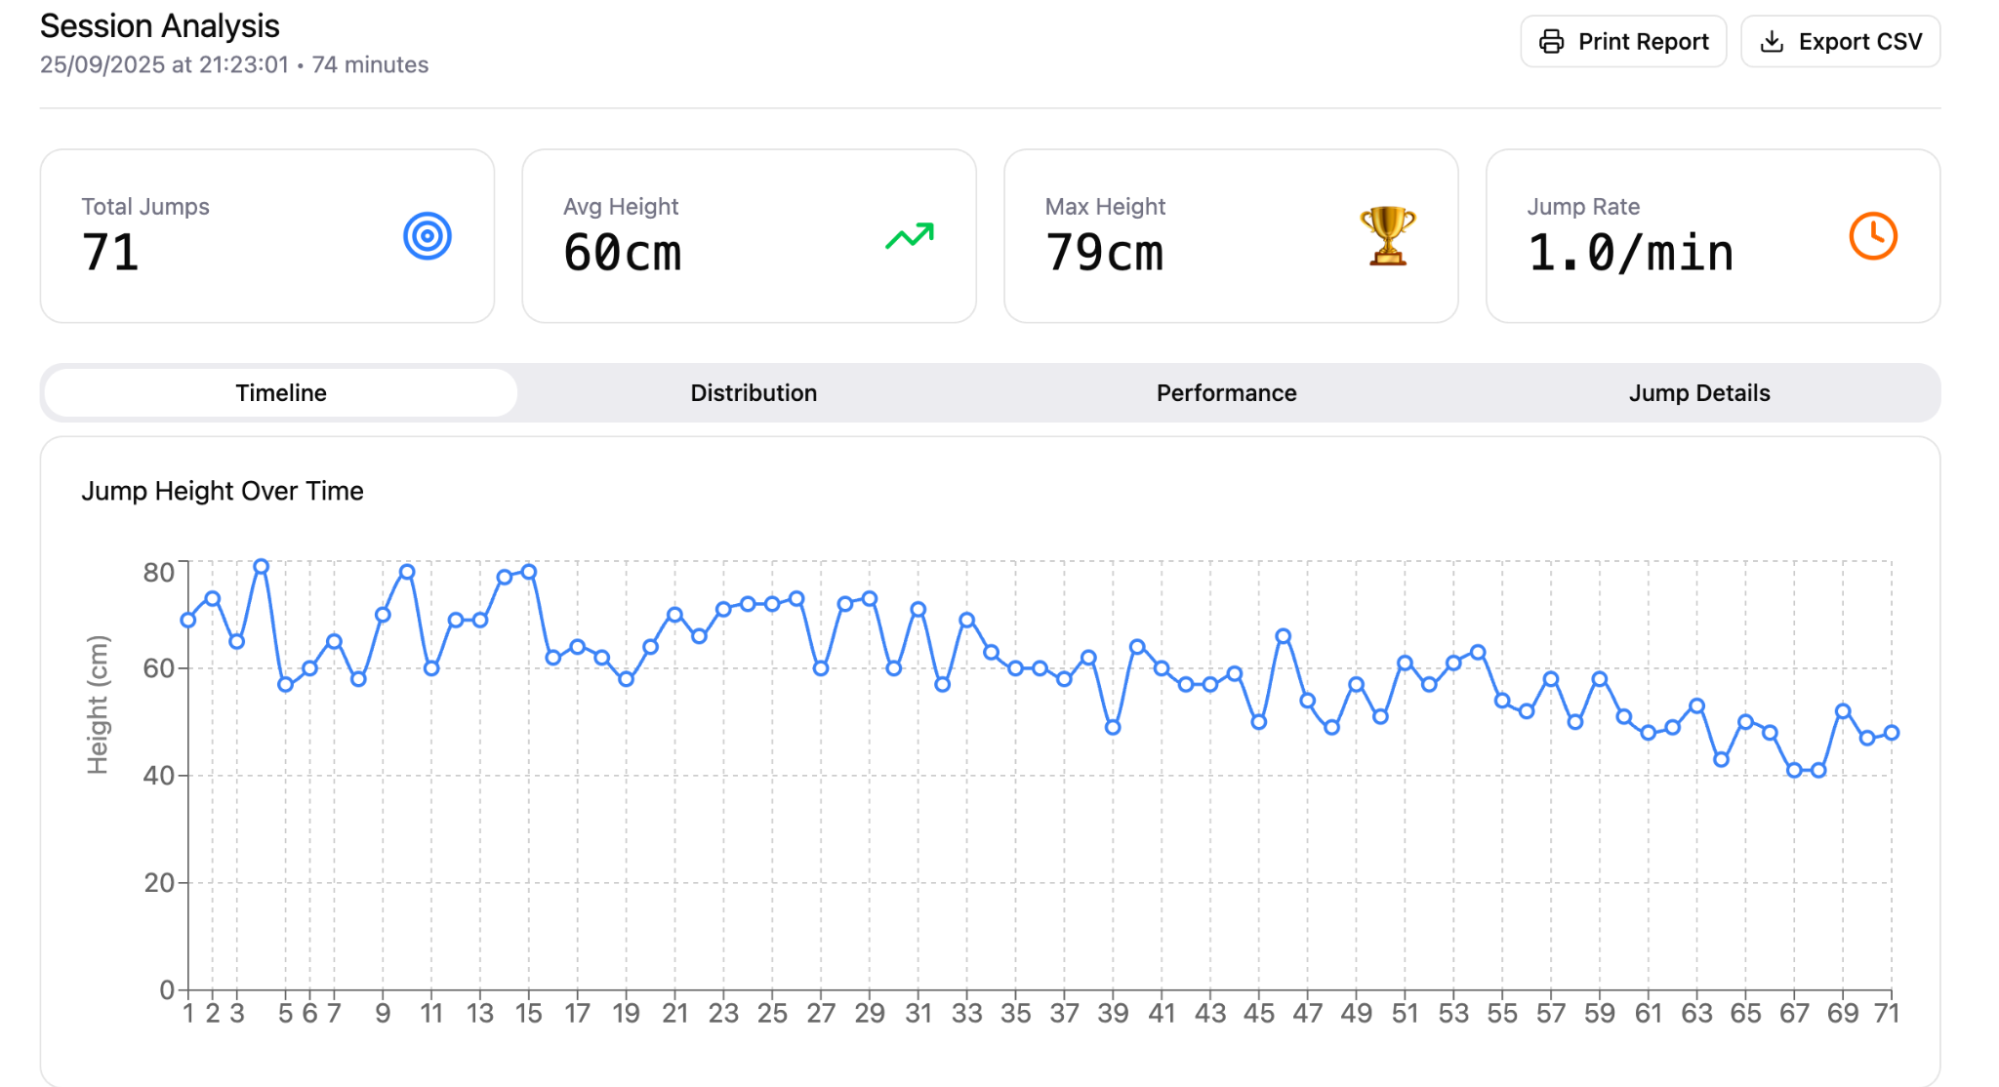
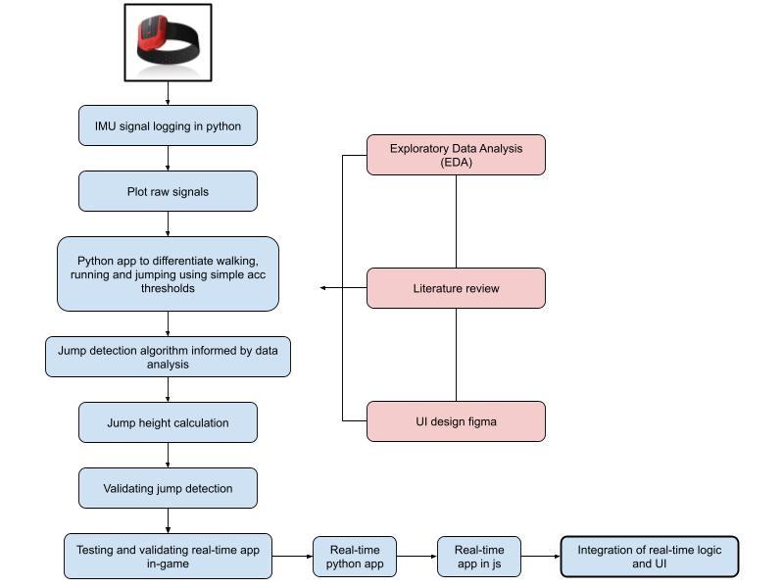
User Interaction
app.py
First step to a workable application to analyse IMU data
First iteration differentiated between walking, running and jumping
Next iteration integrates jump detection and height calculation in a python web app and validate in-field
Jump Height App UI
Design a suitable user interface for coaches and athletes to use in their day-to-day sessions
Notes:
We have created an app prototype user interface which we have shared with our volleyball players for feedback - we intend to adjust according to their feedback
Mention that we are going to validate the system with the National Team - probably down at the Beach
We also created a workable web application with a simpler algorithm in real-time to make sure we could work with a live signal, then the approach will be to bring everything together
SHOW EXAMPLES OF BOTH UI and APP.PY

Slide 6
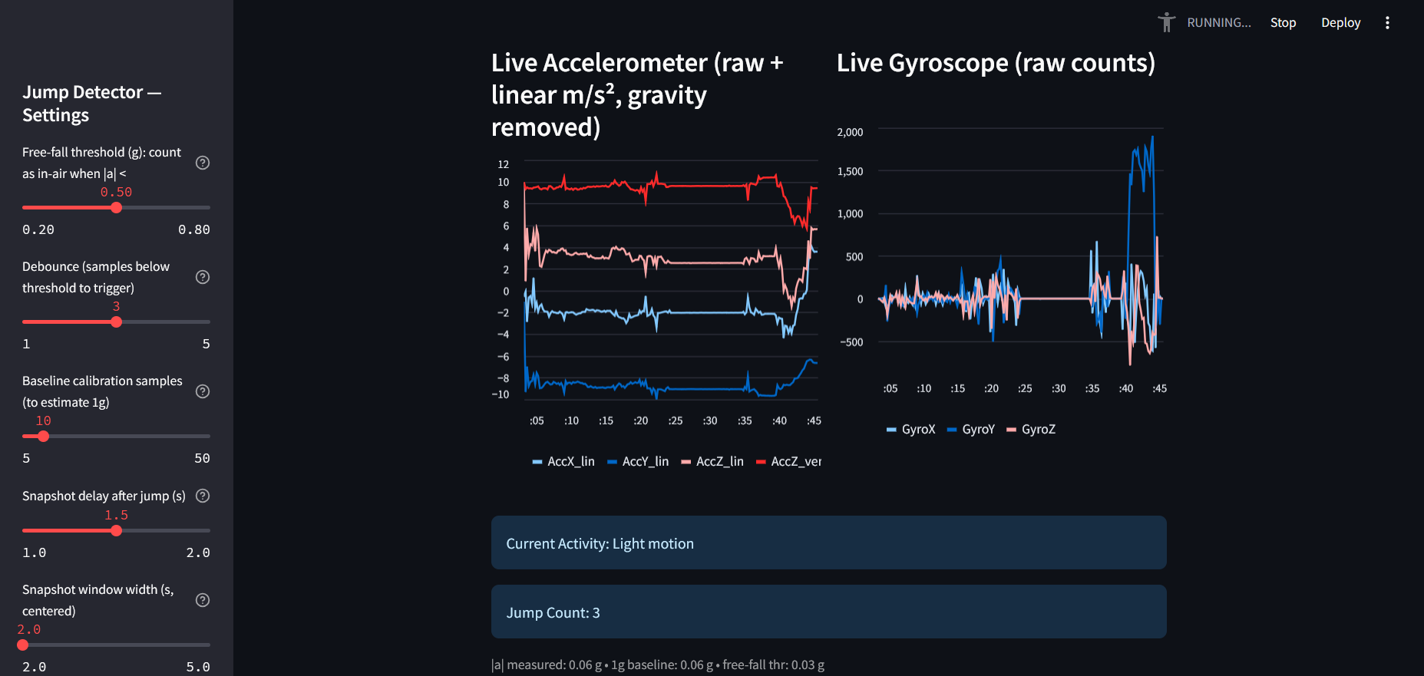
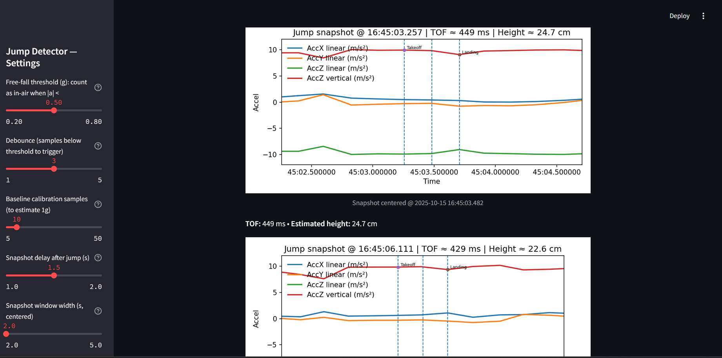
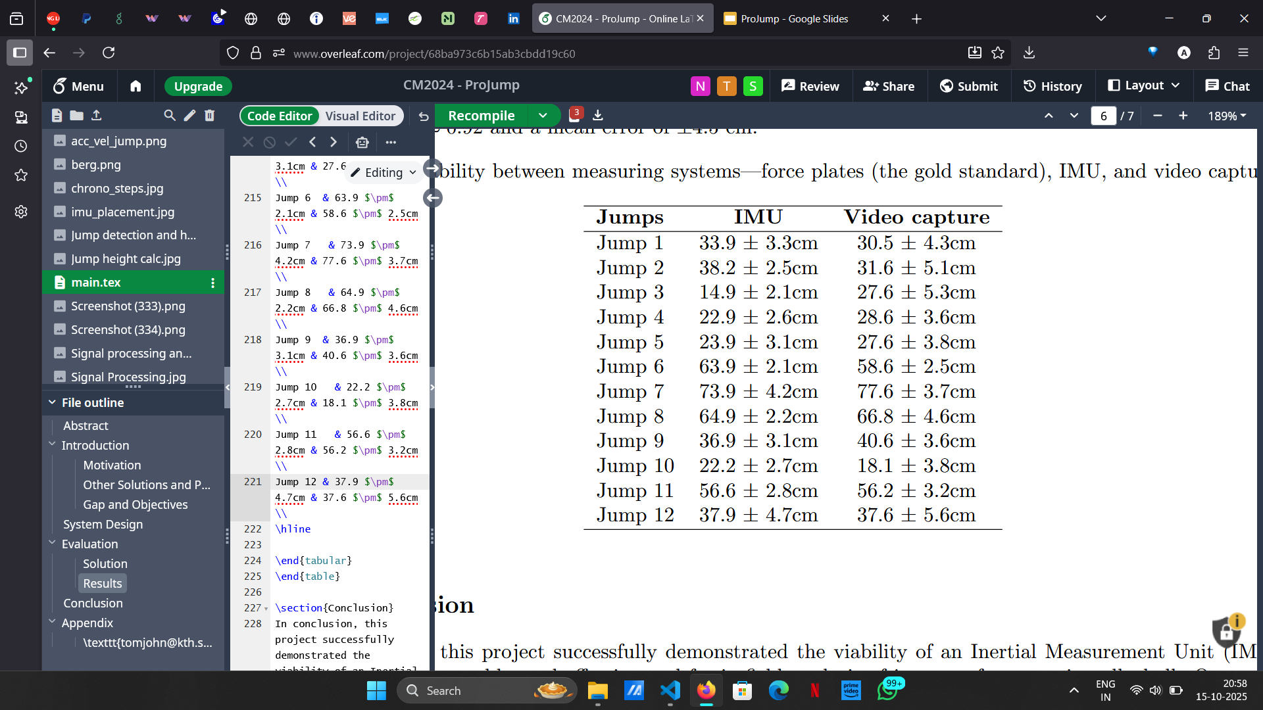
Results
We expect to show that IMU-based predictions are close to ground truth measurements.
A visualization of performance over time helps coaches track progress and detect fatigue or reduced jump height, which could indicate injury risk.
Chest and hip had the most accurate outcomes.
Table 1: Reliability between measuring systems—force plates (the gold standard
Figure: Live charts and Jump detection
Notes:
We expect to show that IMU-based predictions are close to ground truth measurements.
A visualization of performance over time helps coaches track progress, optimise performance and detect fatigue or reduced jump height, which could indicate injury risk.

Slide 7

Project Methodology
Exploratory data analysis
App building and real-time algorithm
POC and validation
Research and literature review of the state of the art practices in IMU sensor handling
EDA using existing datasets to identify the characteristics of jump data to inform the real-time algorithm
Build a simple app to detect different motion in real-time
Prototype user interface for the final application
Incorporate more advanced algorithm from informed by data analysis
Validate methodology against the gold standard - Motion capture
Complete a proof of concept for the end users
Test in-field
ProJump Github repo
Notes:
Research and literature review of the state of the art practices in IMU sensor handling
Using existing datasets to identify the characteristics of jump data to inform the real-time algorithm
Build a simple app to detect different motion in real-time
Prototype user interface for the final application
Incorporate more advanced algorithm from informed by data analysis
Validate methodology against the gold standard - Motion capture
Complete a proof of concept for the end users
Test in-field
What went well?
Complemented each other well in the group
Once we got going we iterated pretty quick
What would we do differently?
Ideation to action in the beginning
Get started earlier (although not our fault really), earlier testing and validating - weren’t sure if we were going to do that at first
More dialogue with the athletes and developers

